Slide 1


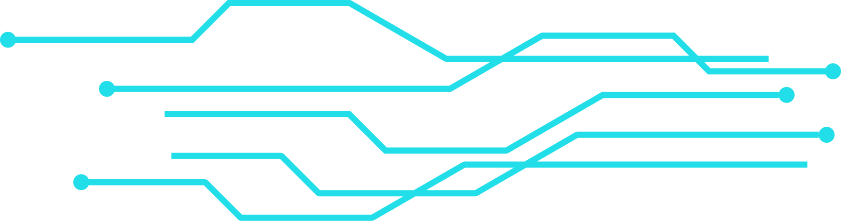
C++ DESKTOP APPLICATION
Introduction to
EHSAN

Slide 2
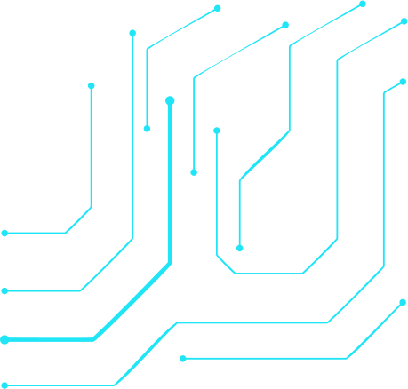
C++ DESKTOP APPLICATION
Ahmed Mohamed Ahmed | 2220037
Asmaa Faisal Mohammed Metwally | 2220073
Ahmed Mohamed Fathy | 2220046
Fares Saad Shaaban Juma | 2220322
Mahmoud ibrahim deif abas | 2220427
Ahmed Mohammed Abdo Abdullah | 2220043

Slide 3
C++ DESKTOP APPLICATION
Ahmed Mohammed Abdel-Hay Ali | 2220042
Mustafa Ismail Fahmy | 2220466
Ahmed Ibrahim Abdel Malik Hussein | 2220009
Mustafa Al-Sayed Muhammad | 2220043

Slide 4
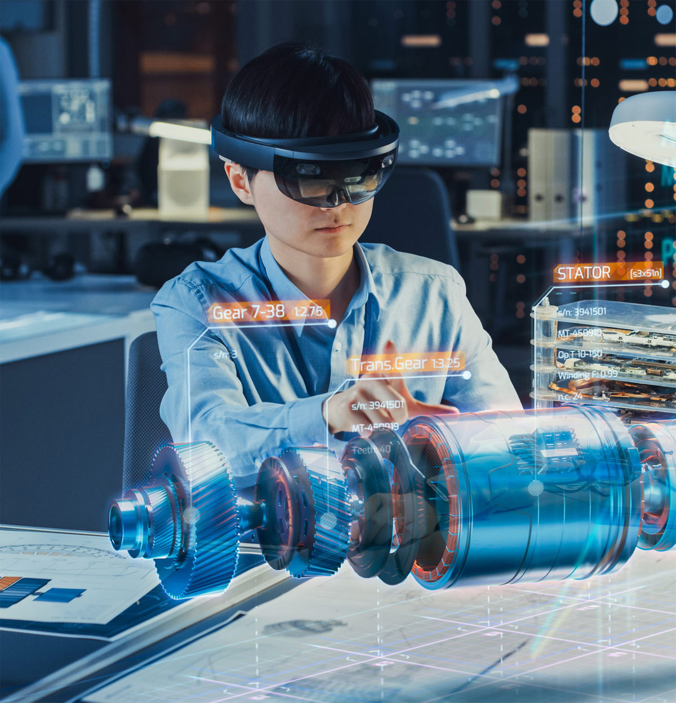

C++ DESKTOP APPLICATION
Project Overview
A desktop application designed to manage the
operations of a charity organization.
Focused on organizing data related to beneficiaries, donors, donations, and volunteers.
Aims to improve efficiency, accuracy, and data security.

Slide 5
C++ DESKTOP APPLICATION
Technical Stack
Component | hnology
Programming Language | C++ using C++/CLI
Framework | .NET Framework
Database | Microsoft SQL Server
Database Connectivity | ADO.NET

Slide 6
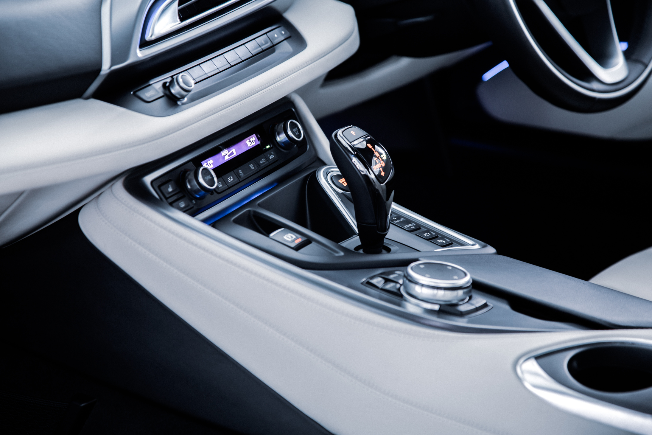
C++ DESKTOP APPLICATION
Why These Technologies
C++/CLI:
Combines native performance with .NET compatibility.
NET Framework:
Ideal for building Windows desktop applications.
SQL Server:
Reliable and scalable database management.
ADO.NET:
Provides efficient, object-oriented database interaction.

Slide 7

C++ DESKTOP APPLICATION
Main Features
Clean and user-friendly interface.
Beneficiary and donor records management.
Donation tracking (cash and items).
Volunteer registration and task assignment.
Report generation and printing.

Slide 8




C++ DESKTOP APPLICATION
System Functionalities
Add/Edit/Delete/View data records.
Advanced search and filtering.
Export data to Excel or PDF.
Role-based access permissions.
Secure login system for administrators.

Slide 9

C++ DESKTOP APPLICATION
Saves time and reduces human errors.
Improves data accessibility and organization.
Ensures data security and integrity.
Supports future scalability and expansion.
Benefits

Slide 10
C++ DESKTOP APPLICATION
Thank you!
DR. MOHAMMED ABDELFATTAH
-
EHSAN TEAM

